Slide 1
Revo Apps Sales Dashboard
Muhamad Rayhand Prasetya

Slide 2
Intermediate

Slide 3
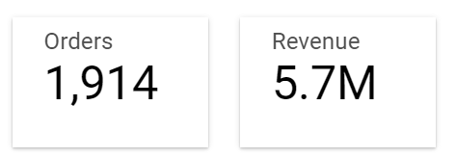
Total Revenue and Number of Orders

Slide 4
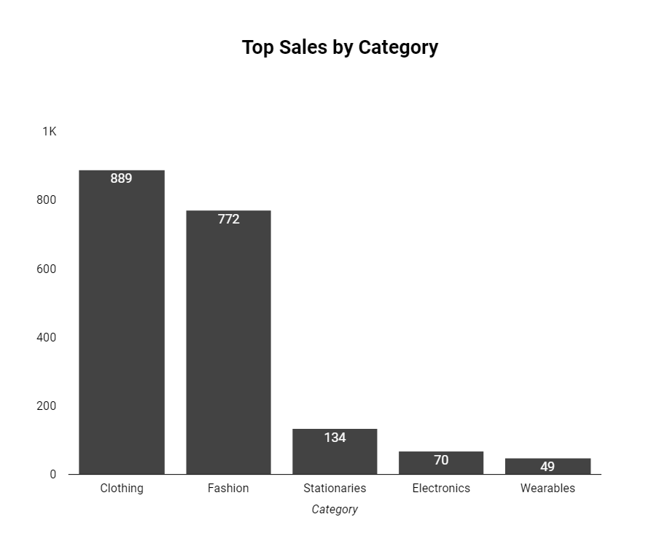
Top 5 highest category based on number of customers

Slide 5
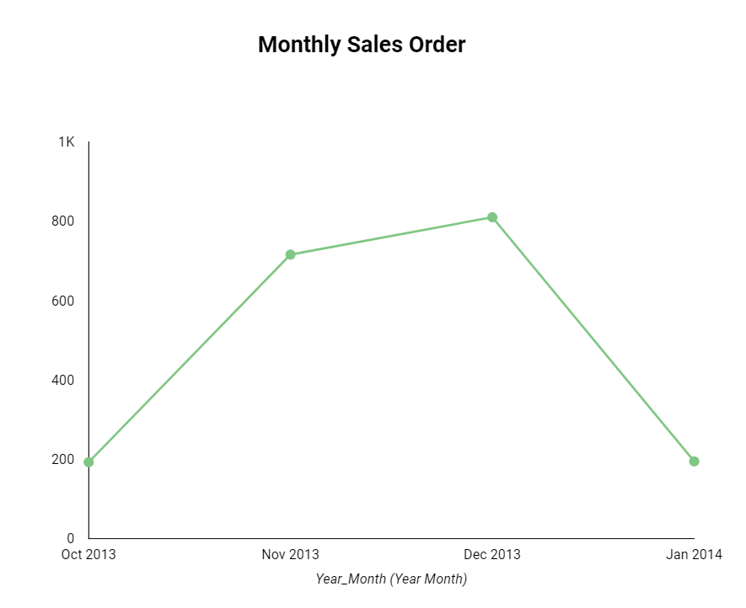
Monthly Sales Order Trend

Slide 6
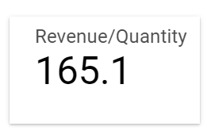
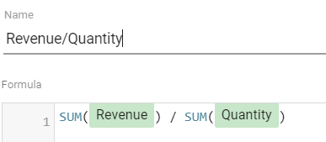
Amount per Quantity

Slide 7
Advanced

Slide 8
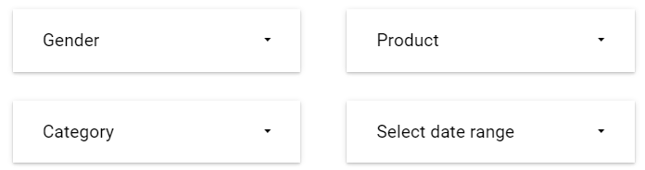
Interactive Dashboard

Slide 9
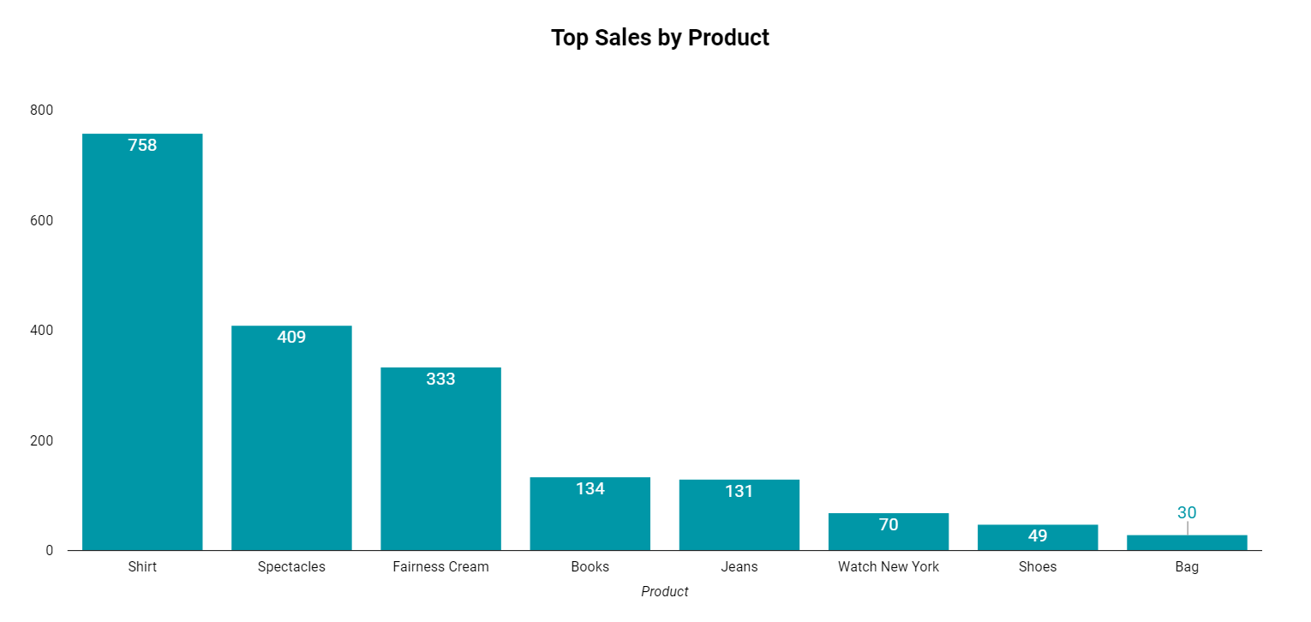
Additional Visualization
Tambahan visualisasi berupa Bar Chart untuk melihat perbandingan penjualan produk tertinggi di antara semua produk yang ada.

Slide 10
Link to Dashboard
https://datastudio.google.com/reporting/667951b2-b6be-41b4-9b88-580a9beffbf1

Slide 11
Thank you

